Slide 1
Graphic Design Principles
Caleb Finamore, Head of Marketing

Slide 2
Who am I?

Slide 3
Caleb Finamore
3 years of design experience
Fluency in Illustrator, Photoshop, and more
Video editor with GoVertical
Studying graphic design next year at Tufts
Head of Marketing for HackBI IV
Visit me at cfinamore2.wixsite.com/portfolio

Slide 4
About this workshop

Slide 5

Overview
Color Theory
Dynamics
Alignment
Trends
The wheel, schemes, temperature, tints/shades
Emphasis, directing attention, and spacing
The golden spiral, rule of thirds, and symmetry
Chronology and situational use

Slide 6
Color theory

Slide 7
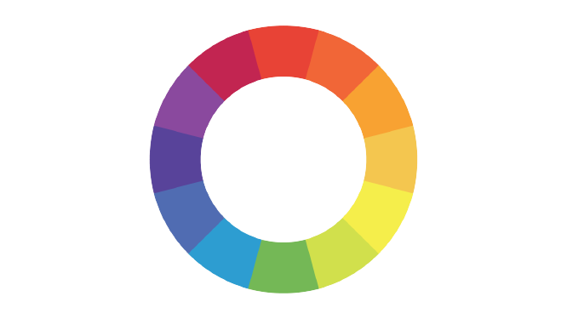

Slide 8
Types of Colors
Primary
Secondary
Tertiary
Red, Yellow, Blue
Orange, Purple, Green
Colors between those

Slide 9
Color Schemes
Analagous (red-orange-yellow)
Complementary (red-green)
Split-complementary (red-cyan-lime)
Triadic (red-blue-yellow)
Rectangular (red-orange-green-blue)
Monochromatic (red)

Slide 10
Temperature
Cool
Warm
Left half
Right half

Slide 11
Tints and Shades
In simple terms:
Tint — color plus white
Shade — color plus black

Slide 12
Dynamics

Slide 13
Dynamics in Brief
Emphasis
Directing Attention
Calling the viewer’s attention to a specific element
Achieved via contrast — color, shape, texture, size, repetition
Achieved via placement
Take advantage of human tendencies
Clusters, diagonal lines, curves, left to right
Think about following naturally with the eye

Slide 14

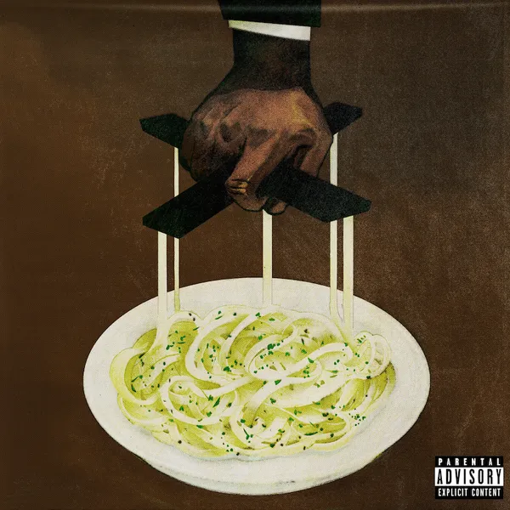
Dynamics Examples

Slide 15
Alignment

Slide 16
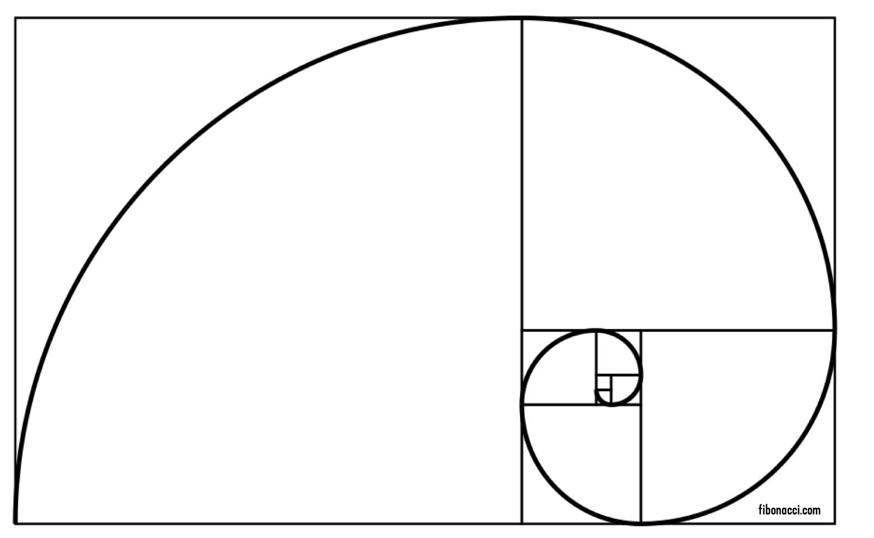
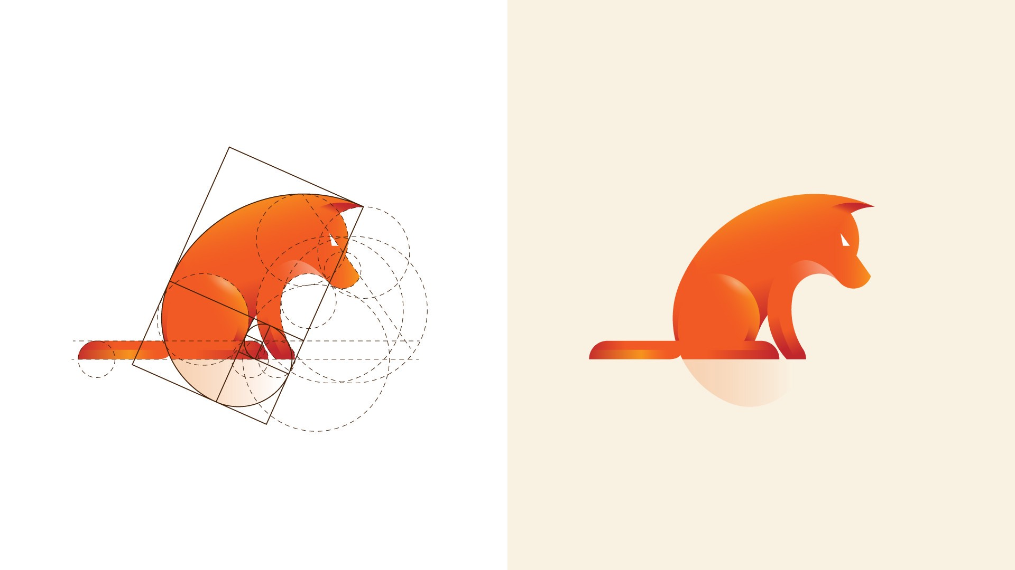
Golden Spiral
Also known as the Golden Ratio
≈ 1.618:1 ratio
Allows for finding proper proportions between elements
Logos, typography, web design, architecture

Slide 17

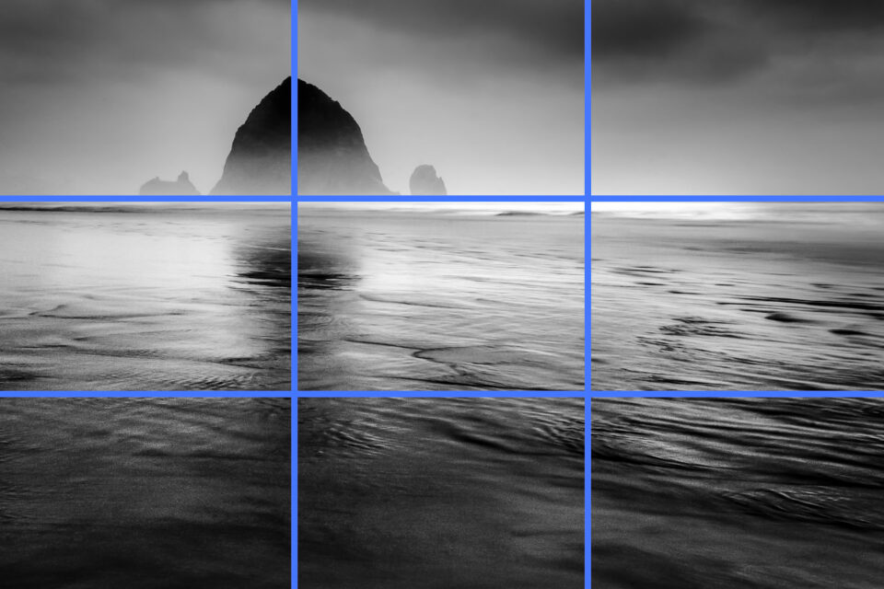
Rule of Thirds
Photography technique in which you divide images into a 3x3 grid
Look to place foci along the intersects or along the gridlines

Slide 18

Symmetry & Asymmetry
“Distribution of elements evenly around a center or axis”
Creates a sense of order and satisfaction
Can be intentionally disrupted

Slide 19


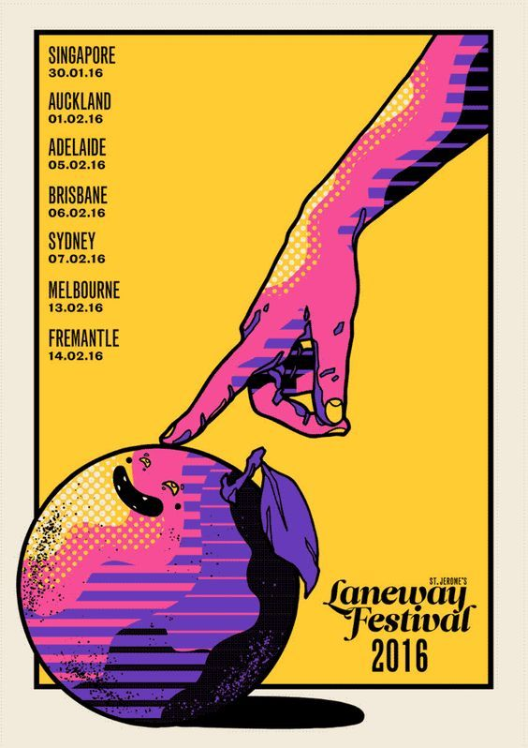
If it works, it works

Slide 20
Trends

Slide 21
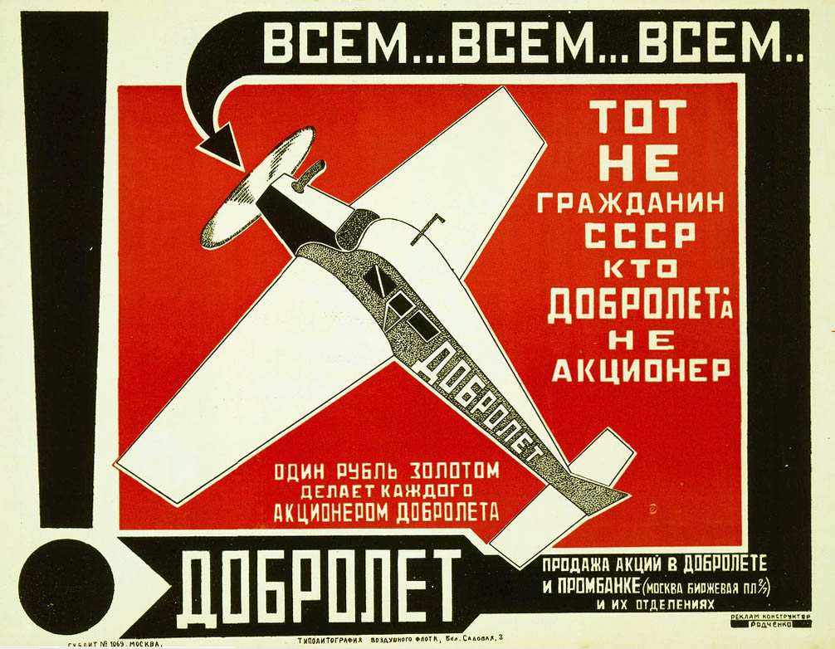

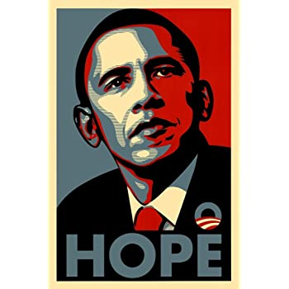
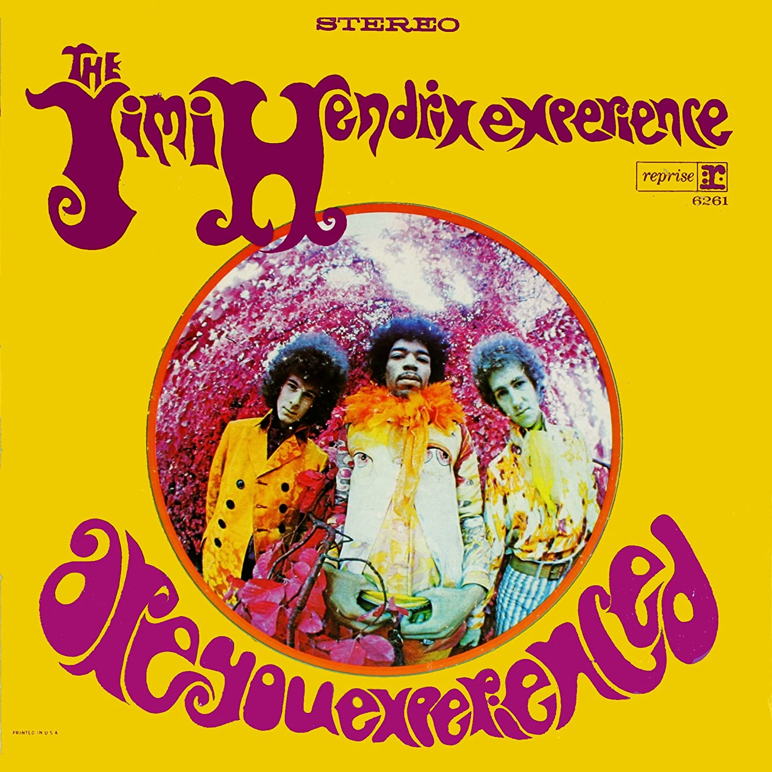

Slide 22
Let’s get to work

